Slide 1

Intro to Data Visualization
CS 625 Data Visualization
Fall 2023
Dr. Michele C. Weigle
https://weiglemc.github.io/teaching/2023-fall-cs625

Slide 2
Today
Before class
Reading: Ch 1 - What's Vis, and Why Do It?
During class
Highlight and discuss Ch 1
We will not cover everything that you are responsible for during class time.

Slide 3
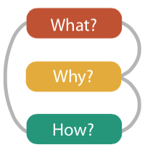
Topic Objectives
Define visualization.
Explain the importance of humans in the visualization process.
Explain why human vision is particularly well-suited for information transfer.
Give an example of a visualization idiom.
Explain why it is best to consider multiple alternatives for vis before selecting a solution.
Explain at a high-level the "what-why-how" framework for analyzing visualization use.
Differentiate between Seaborn, Vega-Lite, D3, and Tableau and describe the type of tasks for which each tool might be most appropriate.

Slide 4
What is visualization?
"The communication of information using graphical representations"
Ward, Grinstein, Keim
"The use of computer-supported interactive visual representations of data to amplify cognition"
Card, Mackinlay, Shneiderman, Readings in Information Visualization: Using Vision to Think
"The purpose of visualization is insight, not pictures."
Ben Shneiderman

Slide 5
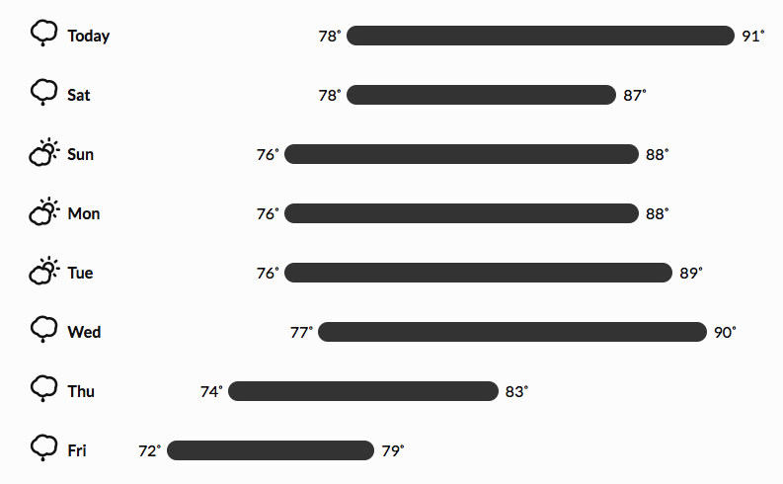
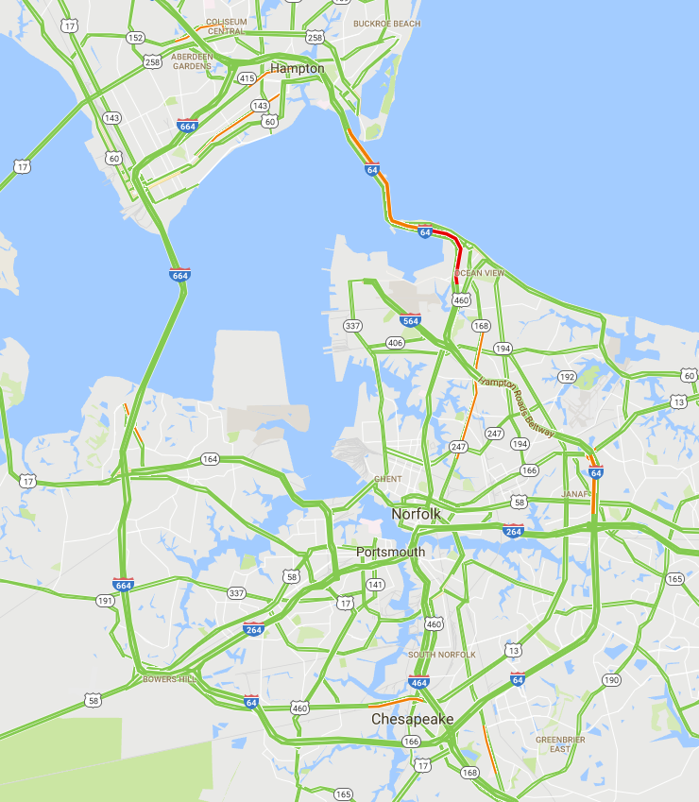
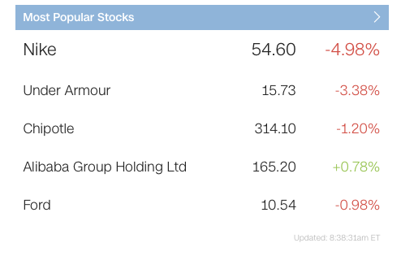
Where have you seen a visualization today?
http://darksky.net
http://google.com/maps/
http://money.cnn.com/data/markets/

Slide 6
What's vis?
Visualization is suitable when there is a need to augment human capabilities rather than replace people with computational decision-making methods.
The design space of possible vis idioms is huge, and includes the considerations of both how to create and how to interact with visual representations.
Vis design is full of tradeoffs, and most possibilities in the design space are ineffective for a particular task, so validating the effectiveness of a design is both necessary and difficult.
Vis designers must take into account three very different kinds of resource limitations: those of computers, of humans, and of displays.
Vis usage can be analyzed in terms of why the user needs it, what data is shown, and how the idiom is designed.
Munzner, pg. 1

Slide 7
Visualization is suitable when there is a need to augment human capabilities rather than replace people with computational decision-making methods.

Slide 8
Why have a human in the loop?
augment human capabilities
Vis allows people to analyze data when they don't know exactly what questions to ask in advance.
Best path - put a human in the loop
exploit the pattern detection properties of human vision

Slide 9


Humans are great at pattern recognition
augment human capabilities
Create visualizations that lets computers do what computers do well and lets humans do what humans do well.

Slide 10
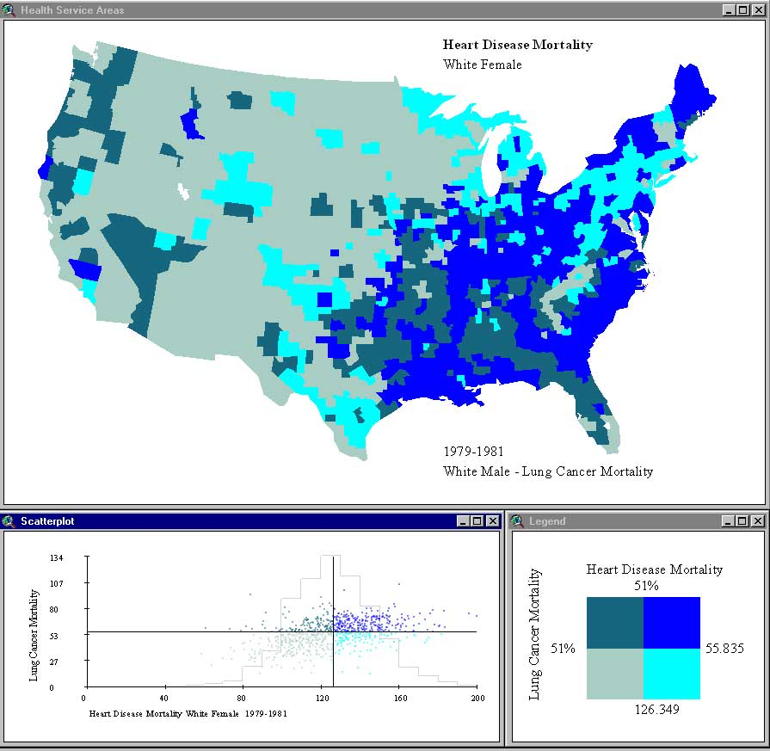
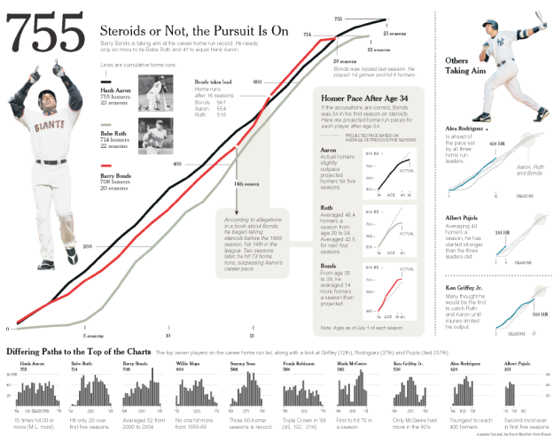
Uses of vis tools
augment human capabilities
Transitional
vis works itself out of a job
Long-term
exploratory analysis
Presentation
visual explanations
https://www.geovista.psu.edu/research/healthvisualization/
New York Times, 2006

Slide 11
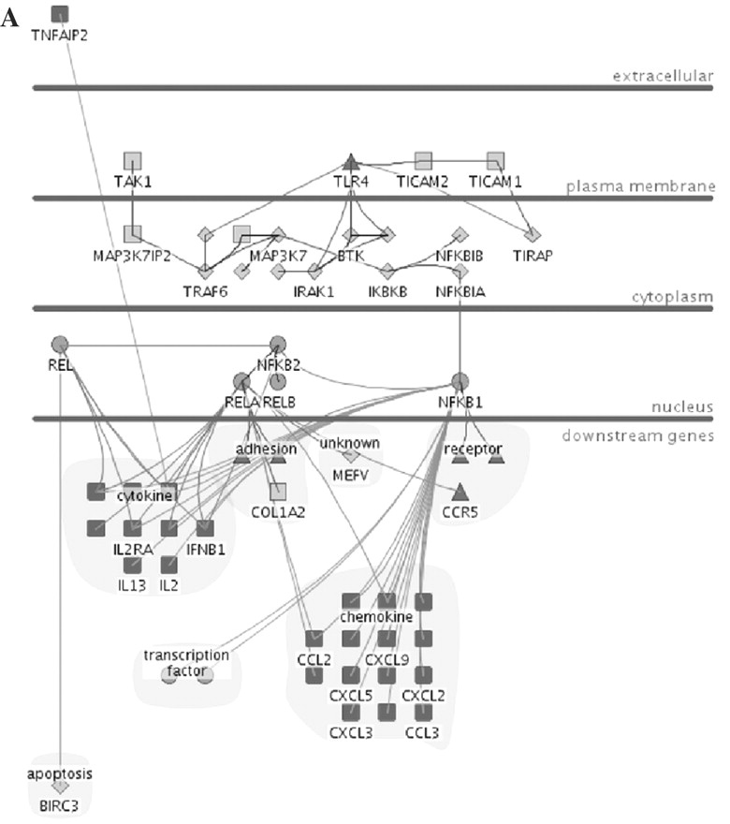
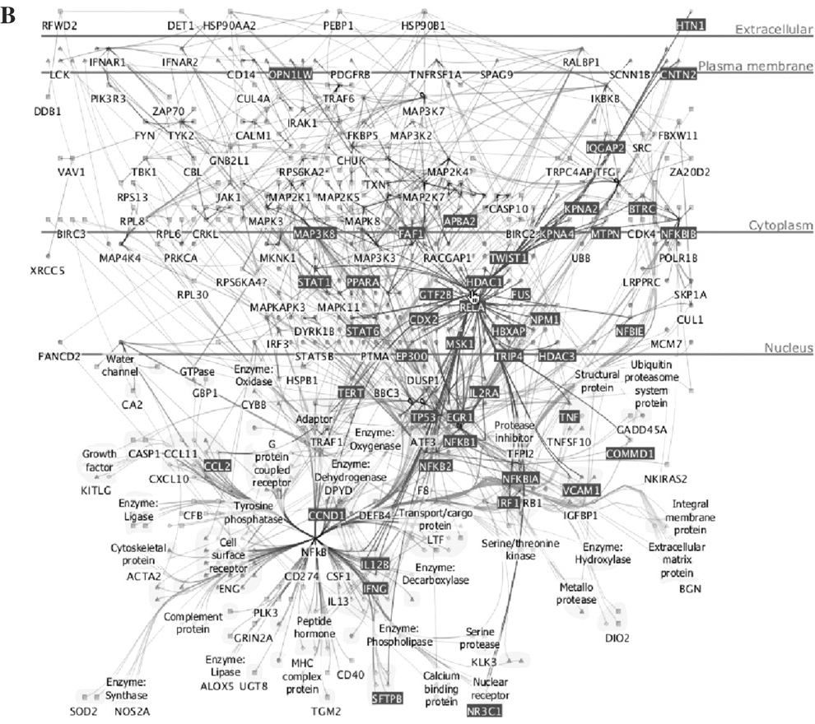
Why have a computer in the loop?
augment human capabilities
Munzner, Fig 1.2 (Barsky et al., 2007)

Slide 12
Why use an external representation?
augment human capabilities
Vis allows people to offload cognition and memory usage to make space for other operations.
Diagrams as external representations
information can be organized by spatial location
search - grouping items needed for problem-solving in one location
recognition - grouping relevant info for one item in the same location

Slide 13
Visualization can extend your memory
augment human capabilities
What is 57 x 48?
paper
mental buffer
5
2
57
x 48
[8 * 7 = 56]
[8 * 5 = 40 + 5 = 45]
1
45
6
[4 * 7 = 28]
22
8
[4 * 5 = 20 + 2 = 22]
2
7
3
6
[8 + 5 = 13]
[4 + 2 + 1 = 7]
Example courtesy Tamara Munzner, Univ. of British Columbia

Slide 14
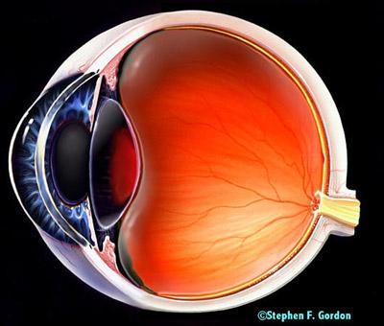
Why depend on vision?
augment human capabilities
Visual system provides a high-bandwidth channel to our brains.
Significant amount of visual information processing occurs in parallel at the pre-conscious level.

Slide 15
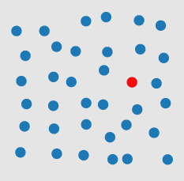
Can you find the red dot?
augment human capabilities
preattentive processing
http://www.csc.ncsu.edu/faculty/healey/PP/index.html

Slide 16
Which state had the highest marriage rate?
augment human capabilities
Colorado - 6.8
Delaware - 5.4
Connecticut - 5.9
District of Columbia - 4.7
Florida - 7.5

Slide 17
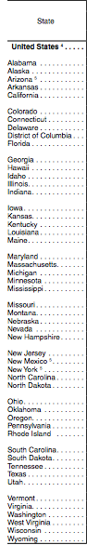
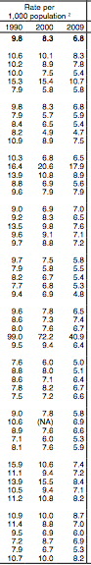
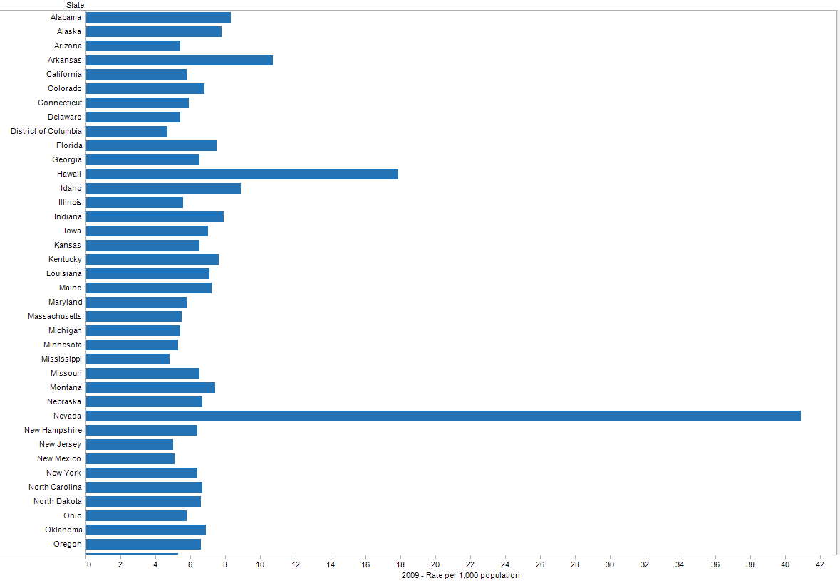
Which state had the highest marriage rate?
augment human capabilities
U.S. Census Bureau, Statistical Abstract of the United States: 2012
https://www2.census.gov/library/publications/2011/compendia/statab/131ed/tables/vitstat.pdf,
http://www2.census.gov/library/publications/2011/compendia/statab/131ed/tables/12s0133.xls

Slide 18
Why show the data in detail?
augment human capabilities
Vis tools can allow people to explore data to find patterns or to determine if a statistical model actually fits the data
Look out for questionable data
"just because it's numbers doesn't mean it's true"
is it a typo or something interesting?
"make sure you know which one it is"

Slide 19
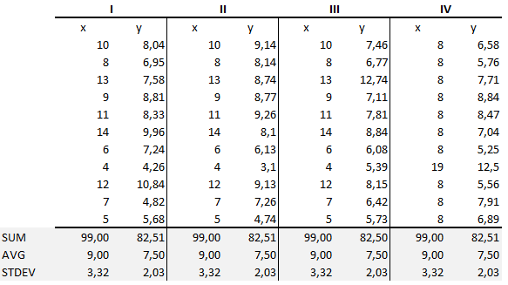
Anscombe's Quartet
augment human capabilities
F.J. Anscombe, "Graphs in Statistical Analysis", American Statistician, Feb 1973
Image from https://medium.com/datadriveninvestor/anscombes-quartet-12649db7eac0, Munzner, Figure 1.3

Slide 20
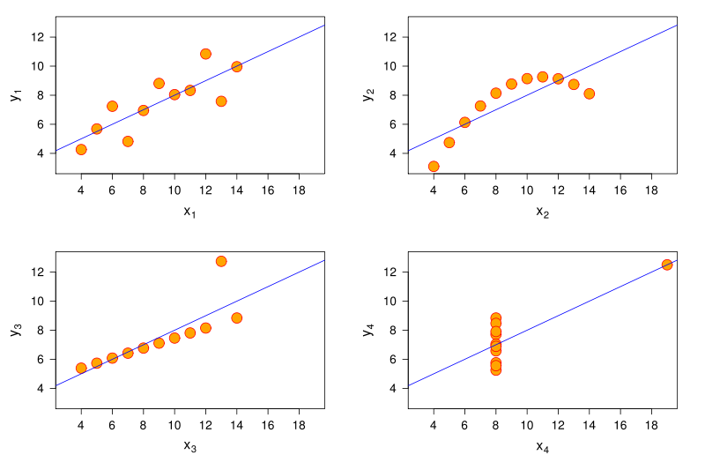
The four data sets are not the same
augment human capabilities
"Graphics reveal data"
- Edward Tufte, The Visual Display of Quantitative Information
http://en.wikipedia.org/wiki/File:Anscombe.svg

Slide 21
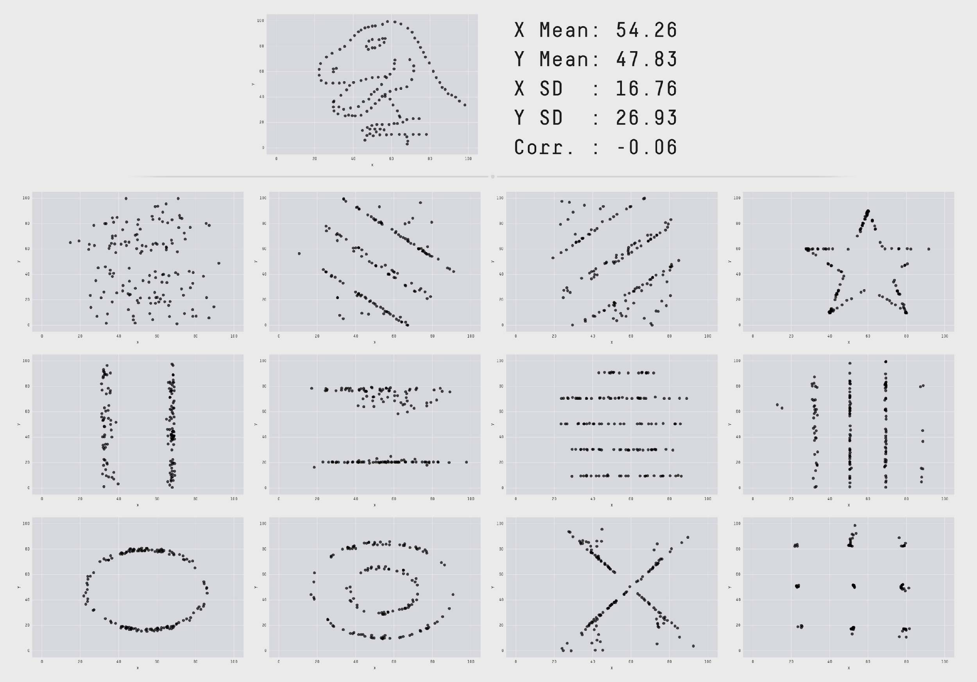
Datasaurus Dozen
https://jumpingrivers.github.io/datasauRus/
https://blog.revolutionanalytics.com/2017/05/the-datasaurus-dozen.html
http://robertgrantstats.co.uk/drawmydata.html

Slide 22
The design space of possible vis idioms is huge, and includes the considerations of both how to create and how to interact with visual representations.

Slide 23
Why is the idiom design space huge?
design space of possible vis idioms is huge
Vis idioms - approaches to creating and manipulating visual representations
Simple examples: scatterplots, bar charts, line charts

Slide 24
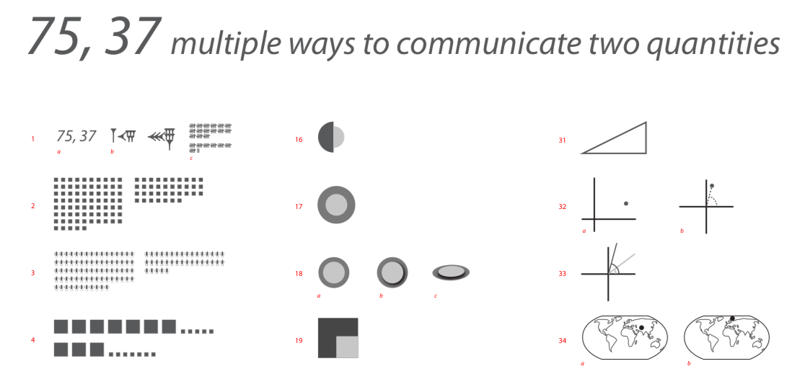
45 Ways to Communicate Two Quantities
design space of possible vis idioms is huge
https://rockcontent.com/blog/45-ways-to-communicate-two-quantities/

Slide 25
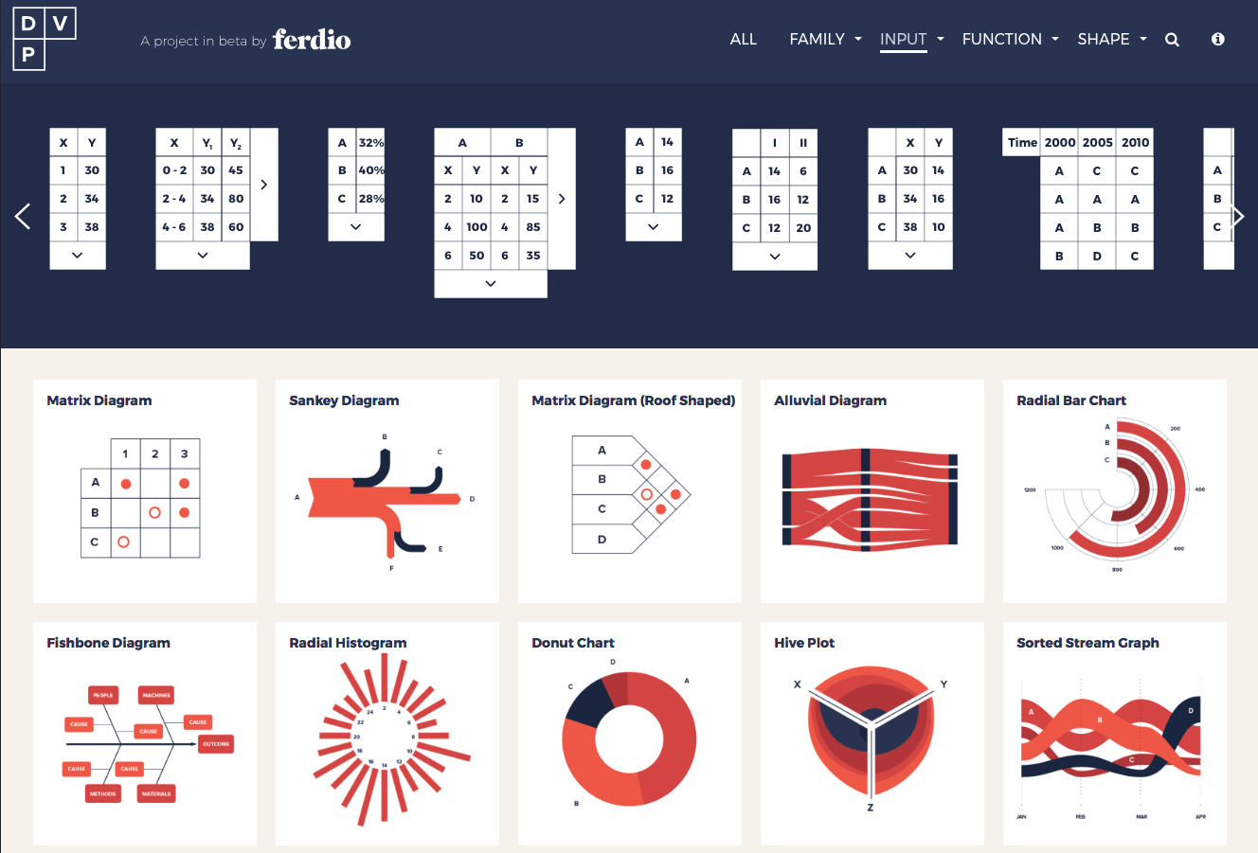
Data Viz Project
design space of possible vis idioms is huge
http://datavizproject.com

Slide 26
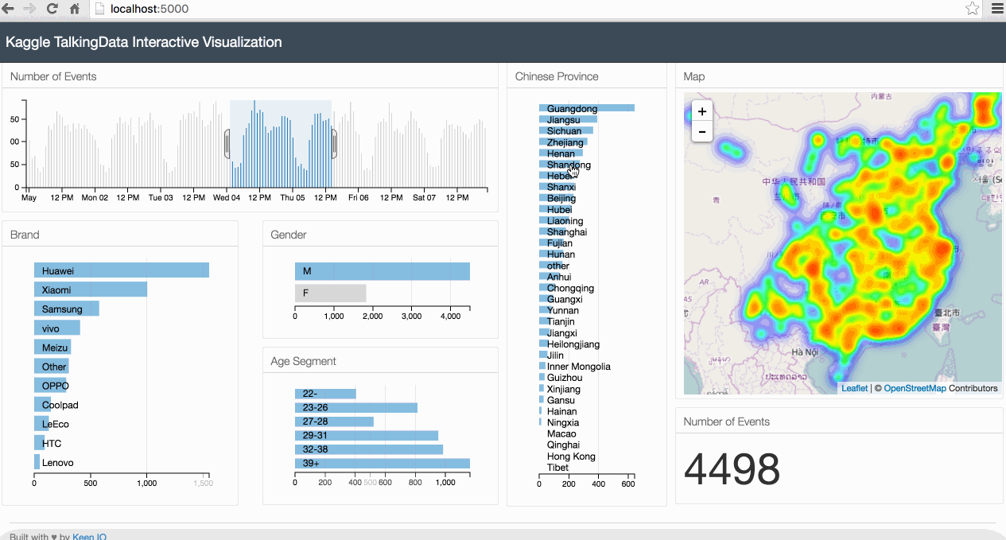
Why use interactivity?
how to interact with visual representations
http://adilmoujahid.com/posts/2016/08/interactive-data-visualization-geospatial-d3-dc-leaflet-python/
Interaction allows for
handling complexity
displaying multiple aspects of a dataset

Slide 27
Vis design is full of tradeoffs, and most possibilities in the design space are ineffective for a particular task, so validating the effectiveness of a design is both necessary and difficult.

Slide 28
Why focus on tasks?
…ineffective for a particular task
The intended task is just as important as the data to be visualized.
Four categories of tasks
presentation
discovery
enjoyment of information
producing more information for later use

Slide 29
Why focus on effectiveness?
most possibilities are ineffective…
Effectiveness is an important measure for understanding if the user task was supported.
"The purpose of visualization is insight, not pictures." -Ben Shneiderman
But, no picture can tell the truth, the whole truth, and nothing but the truth.

Slide 30
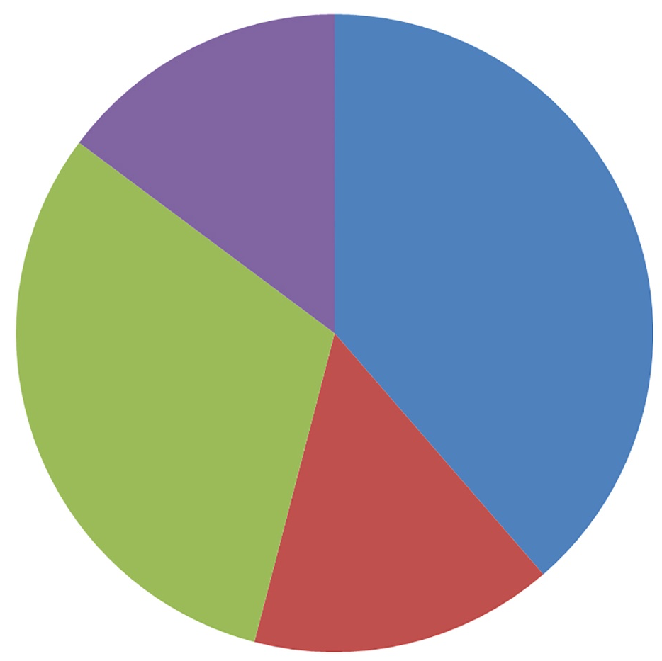
Why are most designs ineffective?
most possibilities are ineffective
Design may not match with human perception
Design may not match with intended task
Which color comprises the greatest portion?
What is the percentage of the green region?

Slide 31
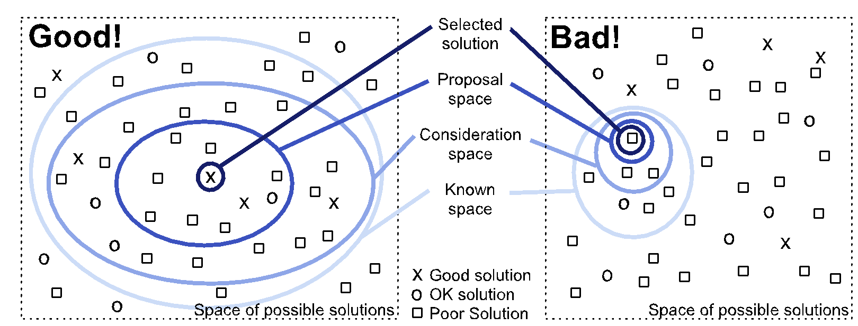
Search space metaphor for vis design
most possibilities are ineffective
Munzner, Fig 1.5

Slide 32
Why is validation difficult?
validating the effectiveness is necessary and difficult
How do you know if your visualization "works"?
How do you measure insight?
How do you argue that one design is better than another?
What does "better" mean? faster? more fun? more effective?
What does "effectively" mean?

Slide 33
Vis designers must take into account three very different kinds of resource limitations: those of computers, of humans, and of displays.

Slide 34
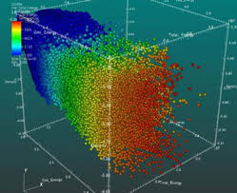
Why are there resource limitations?
take into account resource limitations
computational capacity
human perceptual and cognitive capacity
display capacity
http://bigdata-madesimple.com/30-simple-data-visualization-tools/

Slide 35
Vis usage can be analyzed in terms of why the user needs it, what data is shown, and how the idiom is designed.

Slide 36
Why analyze vis?
Analyzing existing systems is a good stepping stone to designing new ones.
High-level framework for analyzing vis use
what data the user sees
why the user intends to use a vis tool
how the visual encoding and interaction idioms are constructed in terms of design choices

Slide 37
Tools

Slide 38
Workflow
What
data gathering
data wrangling
Why
developing questions
initial analysis
How
charts for analysis
charts for presentation

Slide 39
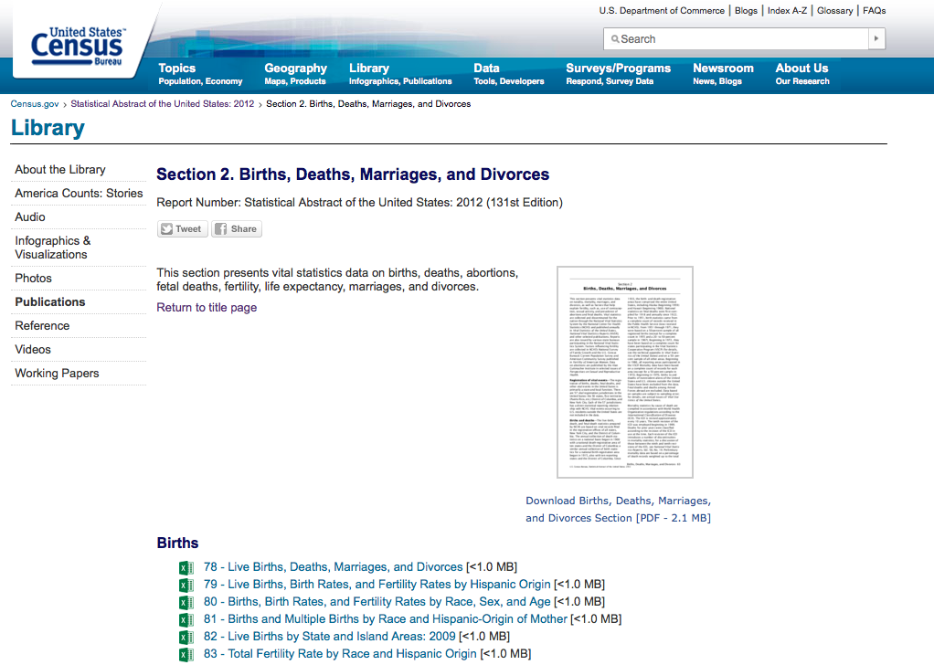
What: Data Gathering
https://www.census.gov/library/publications/2011/compendia/statab/131ed/births-deaths-marriages-divorces.html
Tabula – extract tables from PDFs https://pypi.org/project/tabula-py/
Beautiful Soup – extract data from webpages https://pypi.org/project/beautifulsoup4/

Slide 40
What: Data Wrangling
Data is often messy
Tools
Excel
OpenRefine – filter and clean data files
Much more on this next week

Slide 41
Why
Developing questions
which states have the highest marriage rates?
which states have the highest divorce rates? is that correlated to marriage rate?
which states have the highest birth rates? is that correlated to marriage rate?
Initial analysis
Excel
Google Sheets, Google Charts
Tableau
Python matplotlib, seaborn
Vega-Lite

Slide 42
How
Charts for analysis
Charts for presentation
https://www.geovista.psu.edu/research/healthvisualization/
New York Times, 2006

Slide 43


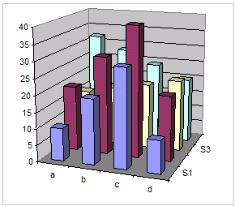
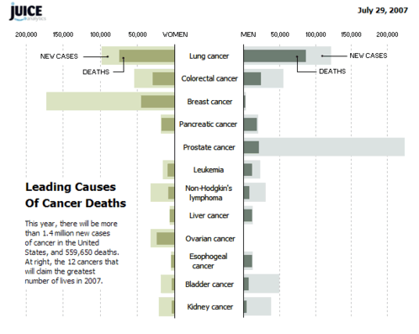
Excel
6 Excel charts you must never use, http://chandoo.org/wp/2008/09/03/6-charts-to-never-use/
Recreating the NY Times Cancer Graph, http://www.juiceanalytics.com/writing/recreating-ny-times-cancer-graph/

Slide 44
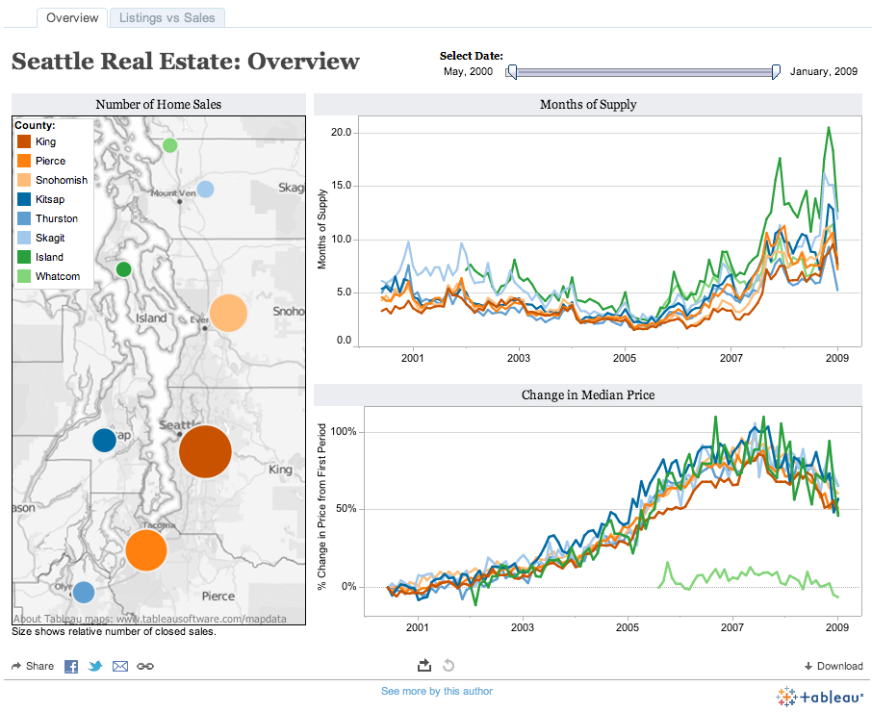
Tableau
https://www.tableau.com/academic/students

Slide 45


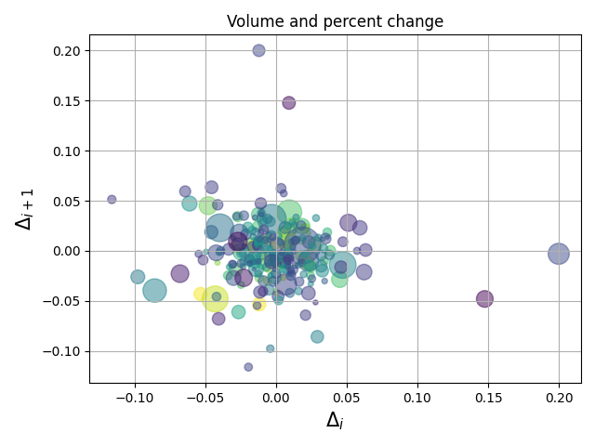
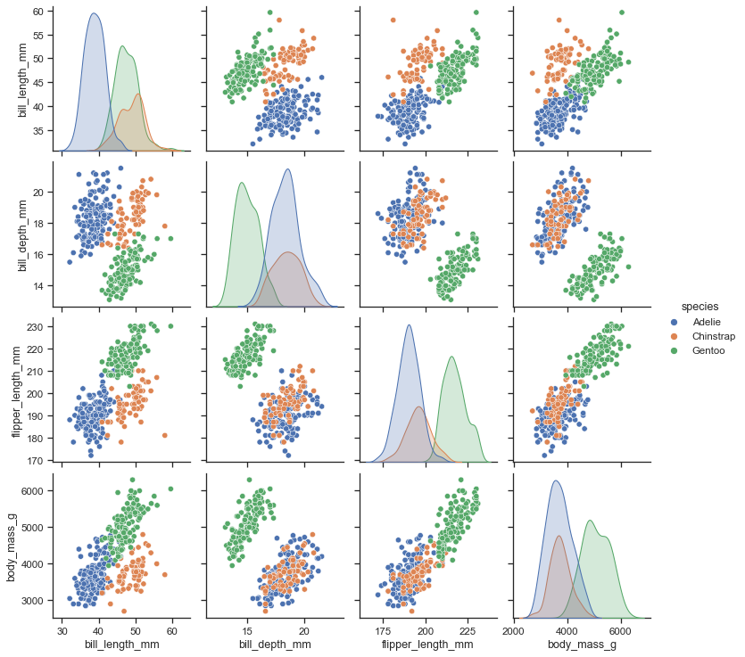
Python
https://matplotlib.org/
https://seaborn.pydata.org/
Other Python visualization libraries:
Plotly - interactive, https://plotly.com/python/
GGplot - based on R's ggplot2, https://pypi.org/project/ggplot/
Altair - based on Vega-Lite, https://altair-viz.github.io/
Bokeh - interactive, https://bokeh.org/
hvPlot - Pandas-like API, can generate Matplotlib, Bokeh, or Plotly plots, https://hvplot.holoviz.org/index.html

Slide 46
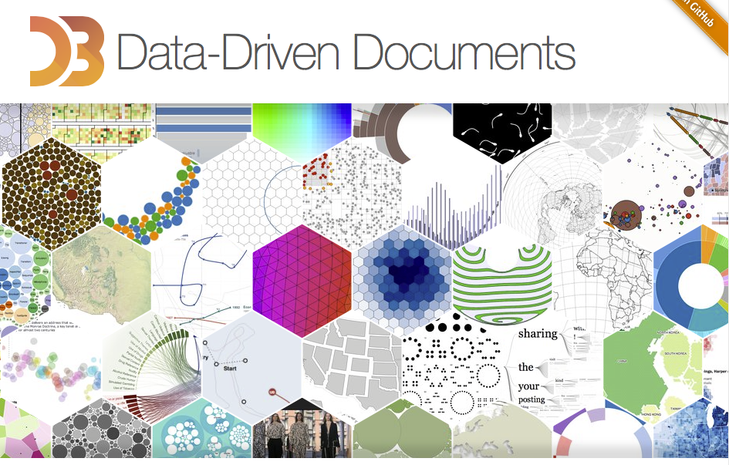
D3
http://d3js.org

Slide 47
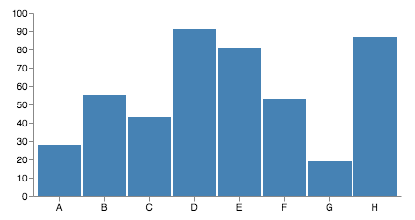
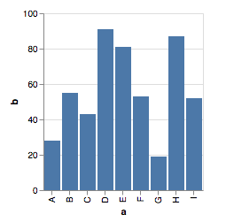
Vega and Vega-Lite
https://vega.github.io/vega/
https://vega.github.io/vega-lite/
Vega is a visualization grammar, built on top of D3
Vega-Lite is a higher-level language built on top of Vega
https://vega.github.io/vega/examples/bar-chart/
https://vega.github.io/vega-lite/examples/bar.html

Slide 48
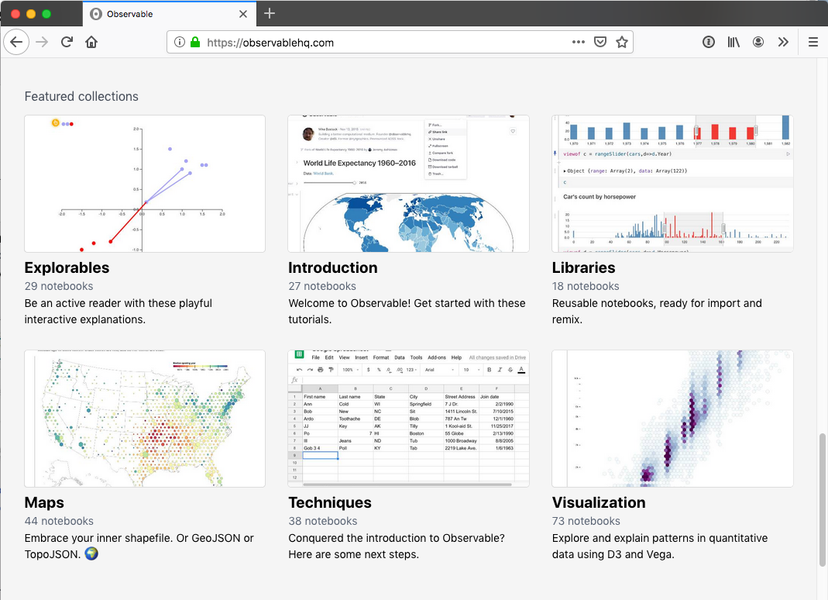
Observable
https://observablehq.com
Notebook-based platform for JavaScript
Build analysis and visualizations using D3, Vega-Lite, or Observable Plot
https://observablehq.com/plot/
Observable Chart cell - no-code option for building, exploring, and customizing charts with Observable Plot, https://observablehq.com/blog/chart-cell, https://observablehq.com/@observablehq/chart-cell

Slide 49
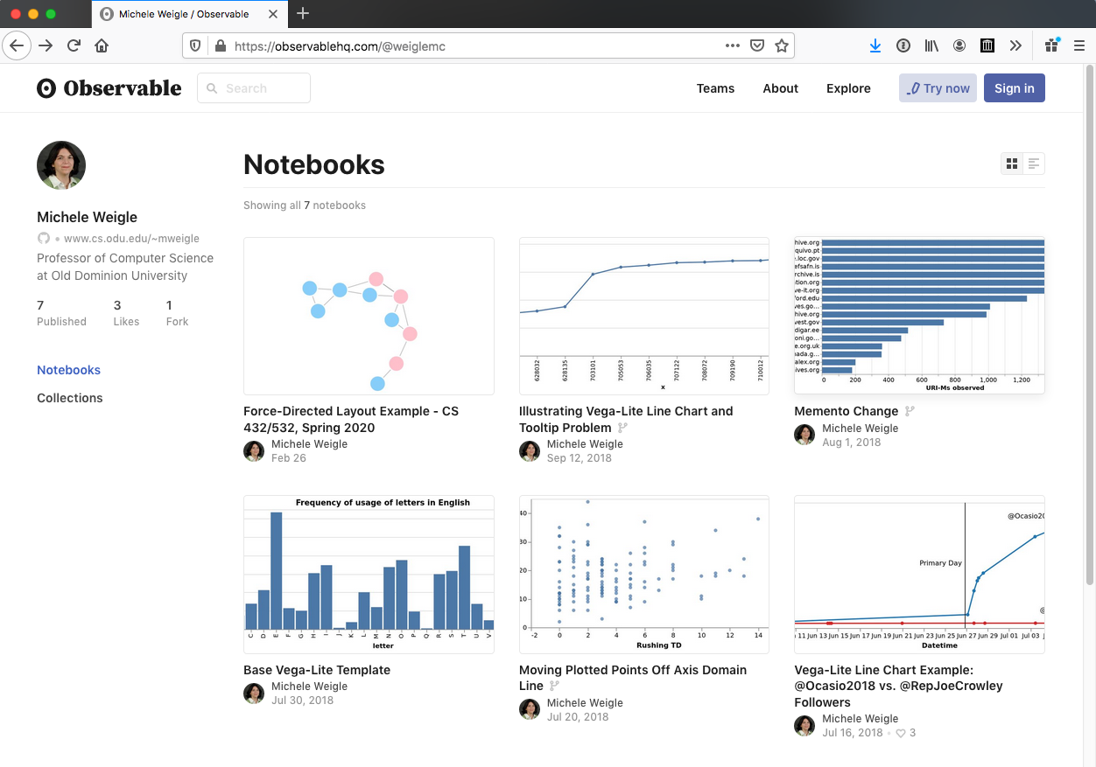
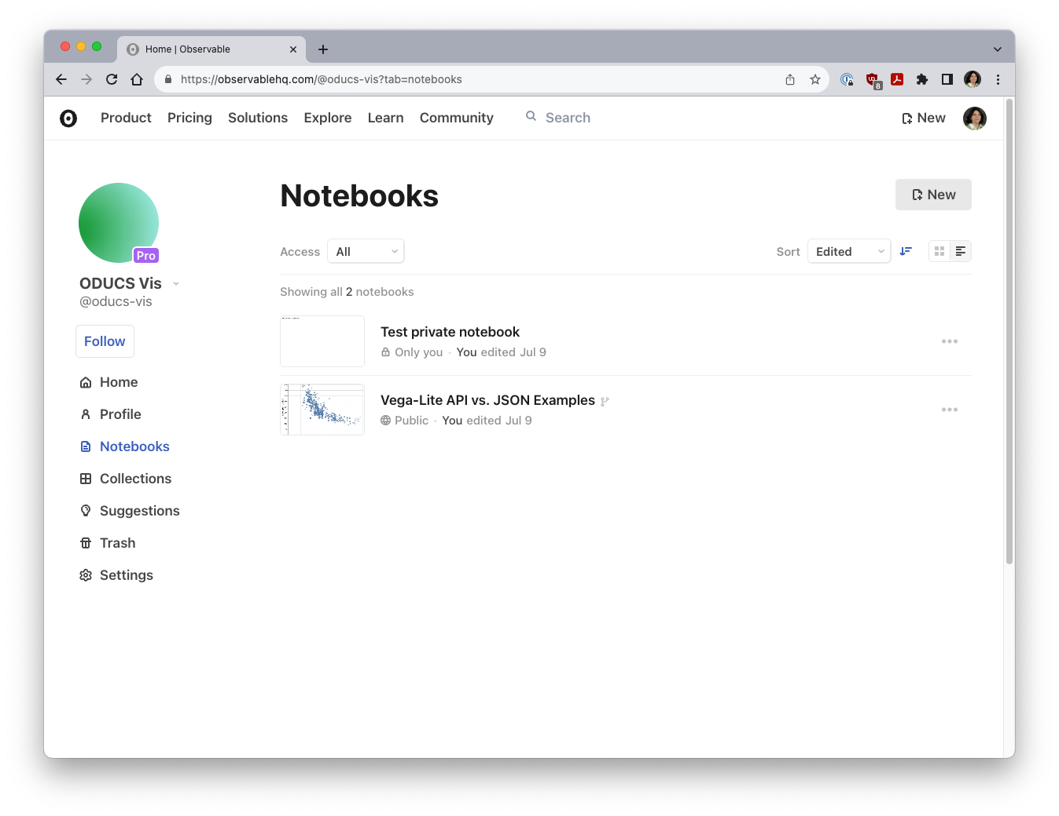
My Observable Notebooks
https://observablehq.com/@weiglemc
https://observablehq.com/@oducs-vis

Slide 50
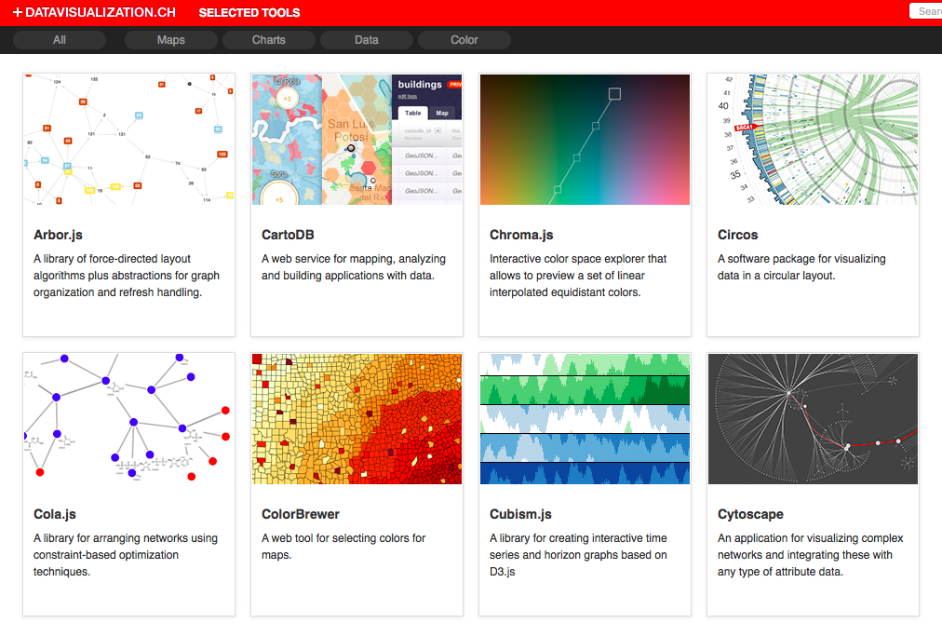
Choosing Tools – datavisualization.ch
http://selection.datavisualization.ch

Slide 51
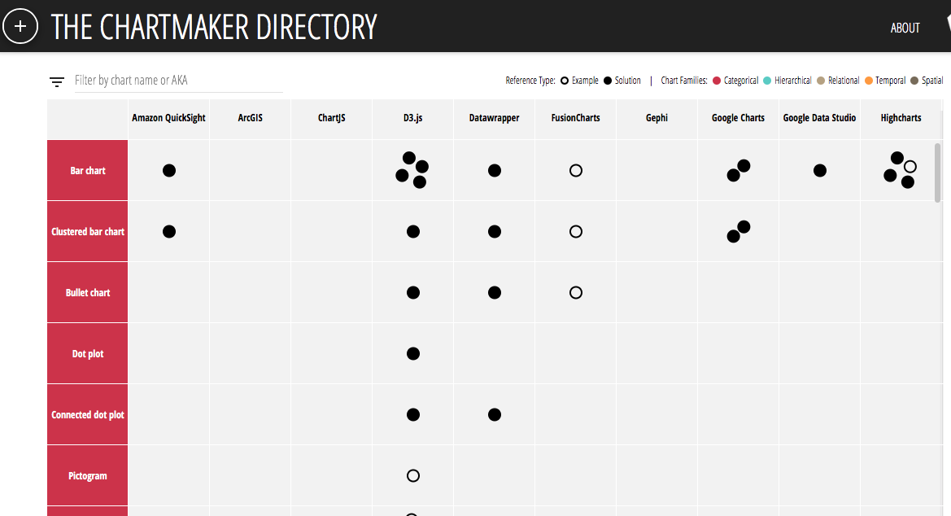
Choosing Tools – chartmaker directory
http://chartmaker.visualisingdata.com

Slide 52
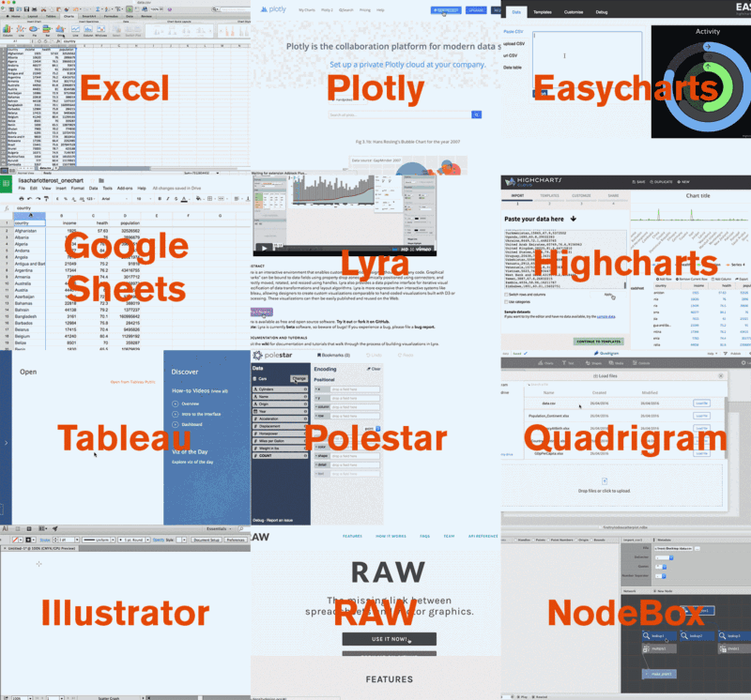
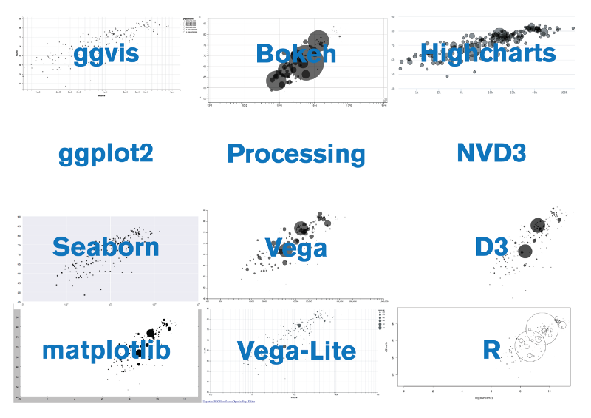
What I Learned Recreating One Chart Using 24 Tools
https://source.opennews.org/en-US/articles/what-i-learned-recreating-one-chart-using-24-tools/

Slide 53
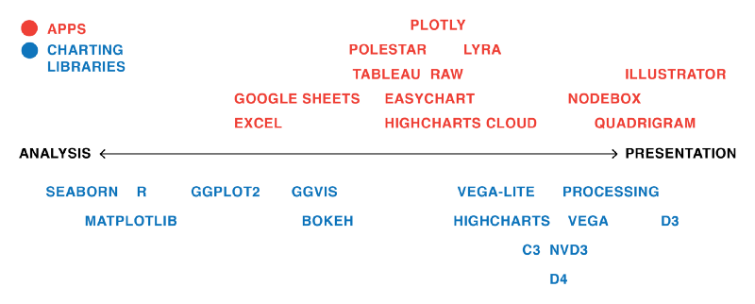
Tools for Analysis vs. Presentation
https://source.opennews.org/en-US/articles/what-i-learned-recreating-one-chart-using-24-tools/

Slide 54
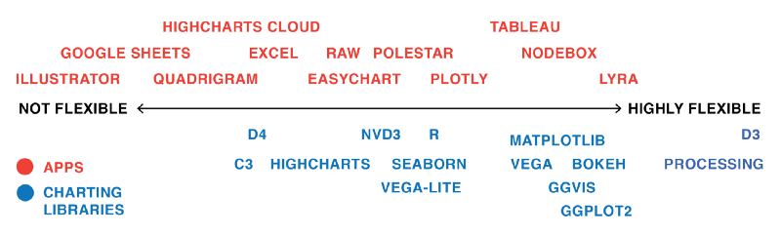
Flexibility of Tools
https://source.opennews.org/en-US/articles/what-i-learned-recreating-one-chart-using-24-tools/

Slide 55
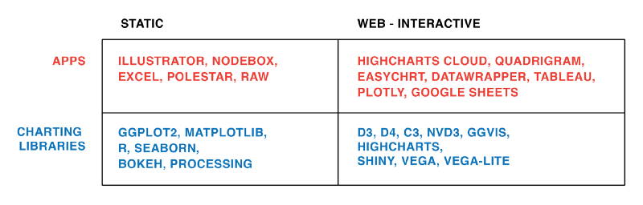
Apps vs. Libraries and Static vs. Interactive
https://source.opennews.org/en-US/articles/what-i-learned-recreating-one-chart-using-24-tools/

Slide 56
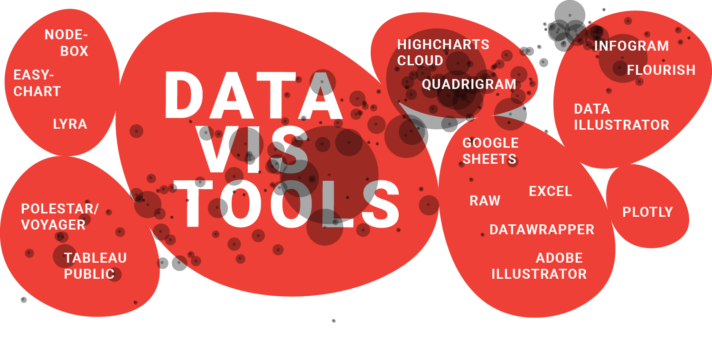
One Chart, Nine Tools – Revisited
https://lisacharlotterost.github.io/datavistools-revisited

Slide 57
Topic Objectives
Define visualization.
Explain the importance of humans in the visualization process.
Explain why human vision is particularly well-suited for information transfer.
Give an example of a visualization idiom.
Explain why it is best to consider multiple alternatives for vis before selecting a solution.
Explain at a high-level the "what-why-how" framework for analyzing visualization use.
Differentiate between Seaborn, Vega-Lite, D3, and Tableau and describe the type of tasks for which each tool might be most appropriate.

